Slide 1
Cloud Architectures & On-prem Enterprise Architectures
Sanjay Gilki

Slide 2

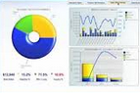
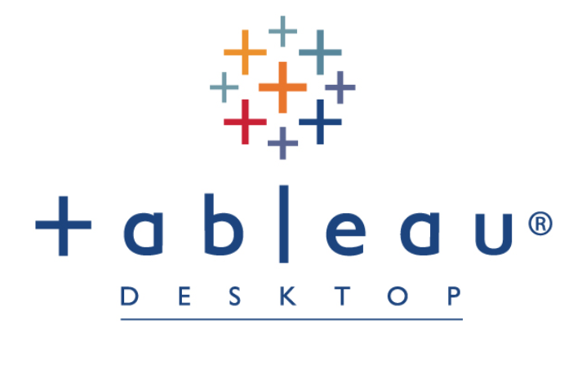

Phase-1 Analytic Solution
Level-1 Security
Level-1 Security
BP Users
Level-2 MFA Security
Level-2 MFA Security
Collect & Place the Data in Highly Secured Cloud folder
Quickly Develop the Dashboard in
Tableau Desktop
Tableau Dashboards Ready to view from Same Highly Secured Cloud folder
End User Can View the Dashboards from Free Tableau Reader
Pros
Quickly Share the Insights
Gain Customer Confidence with Wow Factor
Avoids Manual Report Creation
Dedicated Support
Cons
Unable Process Huge Data
No Automation

Slide 3



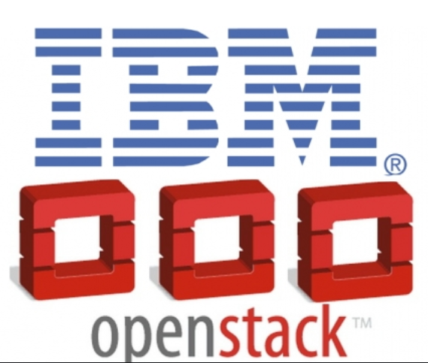
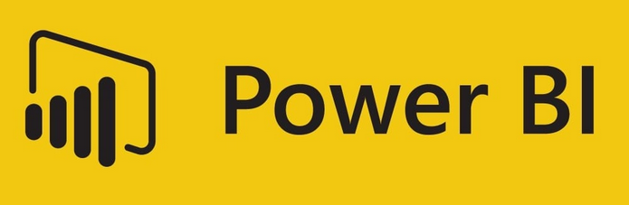


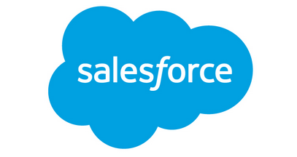
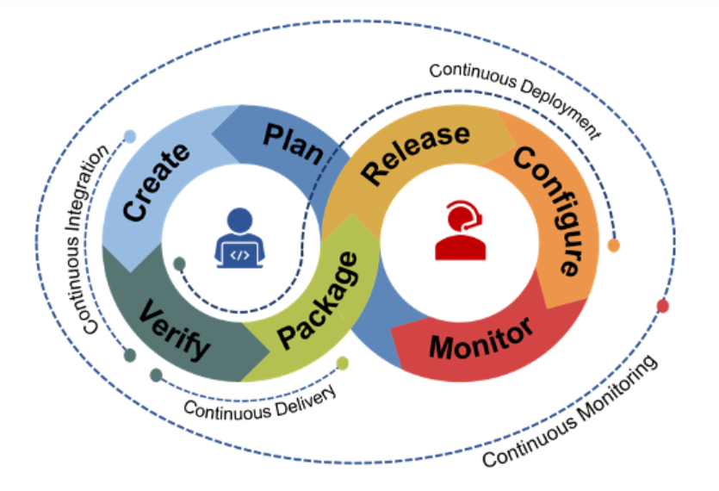
Phase2 - Analytic Solution
Collect Data (Motion/Rest) from BP Systems
Salesforce
SAP MDM
ISP
Cards DB…
Insights
BP Users
Data Science
Master-Nexus
Data Wrangling
CICD
CICD, MDM, Data Governance
Security
Pros
Quickly Share the Insights
Gain Customer Confidence with Wow Factor
Avoids Manual Report Creation
Dedicated Support
Pros
Centralized, SVOT, Realtime
Highly Available & Scalable
Anytime Anywhere
Process Huge Data
Full Automation

Slide 4
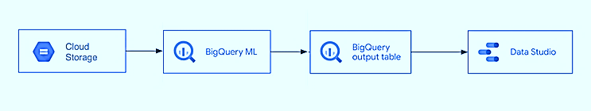
Architecture: Predicting & Forecasting using BigQuery ML

Slide 5




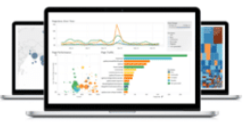

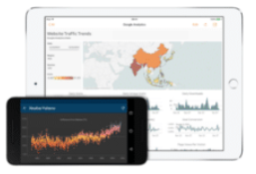






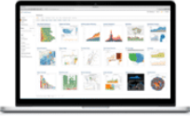




Architecture : Prediction and Forecasting any Time Series Data
(Using Amazon Forecast, R, SageMaker, S3, Athena and QuickSight)
Corporate
data center
AWS Cloud
End Users
AWS glue data catalog
Web
Data Sources
Data
Catalog
Crawler
Data
Catalog
Crawler
Data
Catalog
Crawler
Hand Held Devices
Source Data
Amazon S3
Amazon S3
Amazon S3
Data
Processing
Processed
Data
Amazon Forecast
Model
Out put
Amazon
Athena
Consumption Layer
Amazon QuickSight
Desktop
ARIMA ML Algorithm
Amazon
SageMaker
Data wrangling
(Pre-processing with ML Algorithms)
Amazon
CloudWatch
Notebook

Slide 6
Security, Network, and Access Control
best practices for a standard Azure
3 Tire Aarchitecture [ 2 SDLC Tiers (DEV & PROD) Environments]
Admins
Engineers
22
HUB
On-Prem
PROD
VPN
PUB
PUB
PUB
APP
GW
DC1
PUB
PUB
PUB
DC2
PRIV
PRIV
PRIV
WEB
WEB
APP
APP
DEV
PRIV
PRIV
PRIV
Storage
Account
KV
APP
GW
Automation
Patching
PUB
PUB
PUB
Log Analytics
Azure SQL
RV
Policy
WEB
APP
Azure SQL
PRIV
PRIV
PRIV

Slide 7


Architecture : Prediction and Forecasting any Time Series Data
(Using Amazon Forecast, S3, Athena and QuickSight)
On Premises
AWS Cloud
Users
Availability Zone
Internet gateway
Web
Data Sources
SNOW
Amazon S3
Amazon S3
Amazon S3
Hand Held Devices
Custom SQL
Raw
Layer
Amazon Forecast
Processed Layer
Amazon
Athena
Consumption Layer
Amazon QuickSight
Any TS Data
Desktop
Amazon
CloudWatch
Data wrangling
(Pre-processing with ML Algorithms)
NOTE: Same S3 has different layers (Raw, Pre-processed and Consumption Layers)

Slide 8






AWS Architecture for Batch Processing and Analytic using ML
On Premises
AWS Cloud
Users
Availability Zone
Internet gateway
Web
Data Sources
VPC
AWS glue data catalog
EC2
Instances
Data
Catalog
Crawler
Data
Catalog
Crawler
Data
Catalog
Crawler
Hand Held Devices
File system
ARIMA ML Algorithm
Amazon
Athena
Raw
Layer
AWS
Glue
Processed Layer
Amazon SageMaker
Consumption Layer
Amazon QuickSight
Desktop
Database
AWS
Glue
Amazon CloudWatch
Data wrangling
(Pre-processing with ML Algorithms)

Slide 9
ARIMA Forecasting using AWS SageMaker and AWS QuickSight
for
Any Domain Time Series Data
On Premises
AWS Cloud
Users
Availability Zone
Internet gateway
Web
Data Sources
VPC
Data wrangling
(Pre-processing with ML Algorithms)
Amazon
Athena
Hand Held Devices
File system
Crawler
ARIMA ML Algorithm
Raw Layer
AWS
Glue
Processed Layer
Amazon SageMaker
Consumption Layer
Amazon QuickSight
Database
Desktop
Amazon CloudWatch

Slide 10
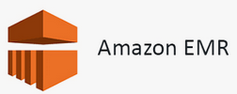
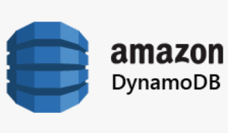

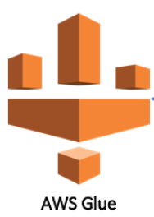


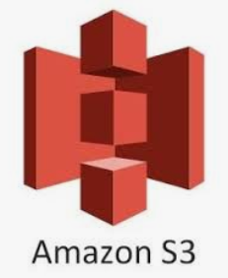
AWS - Database Ingestion Framework
Data Sources
AWS Cloud
Users
Availability Zone
On Premises
Internet gateway
Web
Oracle
Hand Held Devices
MySQL
Desktop
XYZ
Amazon
CloudWatch
Data wrangling
(Pre-processing with ML Algorithms)
NOTE: Same S3 has different layers (Raw, Pre-processed and Consumption Layers)

Slide 11





AWS Architecture for Realtime Reporting and Analytics
On Premises
AWS Cloud
Users
Internet gateway
Availability Zone
AWS glue data catalog
Web
Realtime
Data Sources
Data
Catalog
Crawler
Data
Catalog
Crawler
Data
Catalog
Crawler
Hand Held Devices
ARIMA ML Algorithm
Amazon
Athena
Amazon Kinesis Data Firehose
Raw
Layer
AWS
Glue
Processed Layer
Amazon SageMaker
Consumption Layer
Amazon QuickSight
Desktop
Data wrangling
(Pre-processing with ML Algorithms)
Kafka
Amazon Kinesis Data Streams
Amazon Kinesis Data Analytics
Amazon Kinesis Data Streams
Amazon DynamoDB
Real Time Reporting and Analytics
Kafka and Kinesis Streaming Platforms

Slide 12







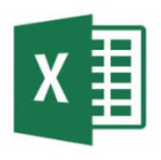

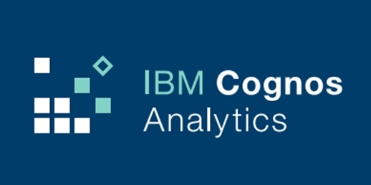

CPaaS As-Is Architecture with Data Flow Diagram
Private Cluster
Internal & External users
ATS System
(HR Tool)
BOT Automation
3 Times a day
Visualization
API
SQL Functions
PTM Dashboard & Reports
Taleo - OBI
Target
1
3
2
Data Science
Business Services
Staging
Landing
Dashboards
HR Data
.csv & xl files
Maste-CPaaS
Machine Learning Model 1….n
IBM Cloud DB and Foundation Services
Notes:
BOT Runs 3 Times a day. It’s from Blue Prism 3rd party
Client/IBM-UHG sends email -> Bot downloads from email -> PM -> Calls Foundation Service import and reads the csv and XL files and loads into landing DB
Oracle Business Intelligence (OBI) : Flexible tool for analysis that helps users gain real-time insight into transactional data, understand data patterns and be alerted to key events and data anomalies. With robust ad-hoc reporting, role-based dashboards, data visualization and self-service information delivery, OBI puts reporting in the hands of business users.

Slide 13
CPaaS As-Is Architecture with Data Flow Diagram
Enterprise Data
Internal & External users
Private Cluster
Object Storage
(S3)
Visualization
BOT Automation
3 Times a day
ATS System
UHG HR Tool
3
1
2
PTM Dashboard & Reports
Taleo - OBI
API
SQL Functions
Staging
Target
Landing
Data Science
HR Data
.csv & xl files
Model 1….n
Dashboards
VM - File Server
Master-cpaas
IBM Cloud DB and Foundation Services
Data wrangling
Notes:
BOT Runs 3 Times a day. It’s from Blue Prism 3rd party
Client/IBM-UHG sends email -> Bot downloads from email -> PM -> Calls Foundation Service import and reads the csv and XL files and loads into landing DB
Oracle Business Intelligence (OBI) : Flexible tool for analysis that helps users gain real-time insight into transactional data, understand data patterns and be alerted to key events and data anomalies. With robust ad-hoc reporting, role-based dashboards, data visualization and self-service information delivery, OBI puts reporting in the hands of business users.

Slide 14
Process flow Diagram for DevOps for DB (DataOps)
Data Science Team
Data Team
UI Team
Service Team
Identify DDL/DML scripts and create JIRA task with all the details
List of DDL and DML objects names will be captured in the SQL changeset file to the in their respective Git repositories.
If
Data Governance Team Approved? Merge the Release branch with DEVELOPMENT branch
?
NO
YES
cpaas-ptm-database-application automatically execute NEW files only
(Already executed files will NOT be executed again)

Slide 15
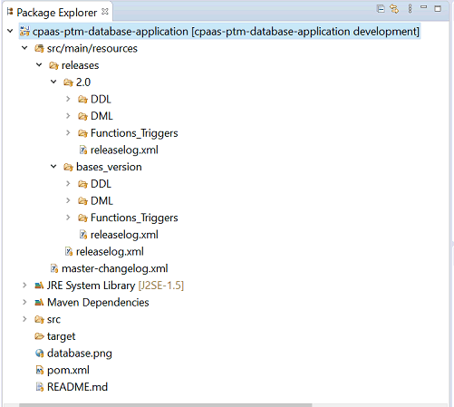
DevOps
Will pick these files and execute the SQL scripts in the respective assigned environments
All scripts are kept in respective release component wise folder
All pom.xml, changesetlog.xml, releaselog.xml and master-changelog.xml are updated.

Slide 16
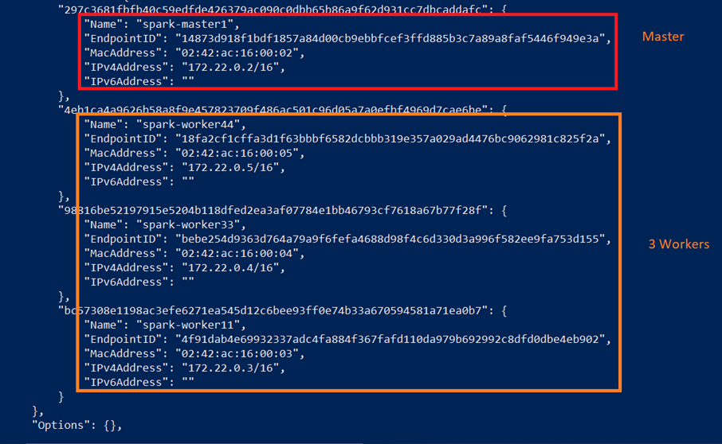
Spark cluster in Dockers and Containers

Slide 17

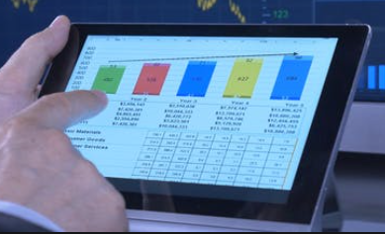




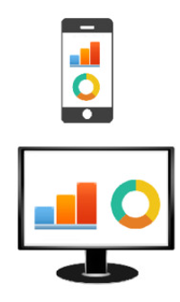

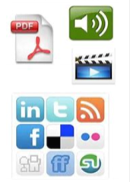
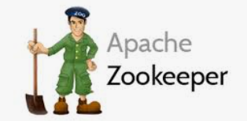
CPaaS - Easy Scalable Cloud-agnostic Real Time To-Be Architecture
Data
Collect
Process
Store
Analyse
Motion Data
Private Cluster
Structured Data
Un Structured Data
IBM Cloud DB and Foundation Services

Slide 18
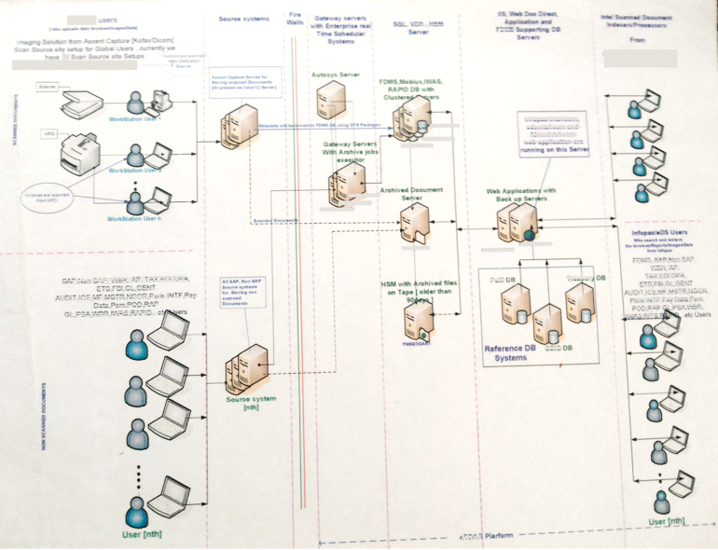
EAI Finance application for Global multi regions

